Slide 1

Internet Programming
Chapter 3​
Threads
School of Computer and Software, Shenzhen University

Slide 2
Contents
What is a thread ?
Define and launch a thread
The life-cycle of a thread
interrupt a thread
thread synchronization
other issues

Slide 3
What is a thread ?
A sequential (or single-threaded) program is one that, when executed, has only one single flow of control.
i.e., at any time instant, there is at most only one instruction (or statement or execution point) that is being executed in the program.
A multi-threaded program is one that can have multiple flows of control when executed.
At some time instance, there may exist multiple instructions or execution points) that are being executed in the program
Ex: in a Web browser we may do the following tasks at the same time:
1. scroll a page,
2. download an applet or image,
3. play sound,
4 print a page.
A thread is a single sequential flow of control within a program.

Slide 4
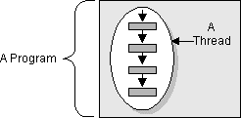
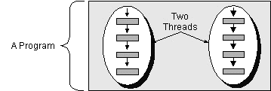
single-threaded vs multithreaded programs
{ A();
newThreads {
{ A1(); A2(); A3() };
{B1(); B2() }
}
}
{ A(); A1(); A2(); A3();
B1(); B2(); }

Slide 5
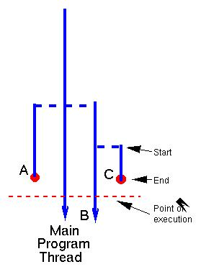
Thread ecology in a java program
started by java from main(String[])
started by main thread
started by B thread
lifetime of C thread

Slide 6
2. Define and launch a java thread
Each Java Run time thread is encapsulated in a java.lang.Thread instance.
Two ways to define a thread:
1. Extend the Thread class
2. Implement the Runnable interface :
package java.lang;
public interface Runnable { public void run() ; }
Steps for extending the Thread class:
Subclass the Thread class;
Override the default Thread method run(), which is the entry point of the thread, like the main(String[]) method in a java program.

Slide 7
Define a thread
// Example:
public class Print2Console extends Thread {
public void run() { // run() is to a thread what main() is to a java program
for (int b = -128; b < 128; b++) out.println(b); }
… // additional methods, fields …
}
Impement the Runnable interface if you need a parent class:
// by extending JTextArea we can reuse all existing code of JTextArea
public class Print2GUI extend JTextArea implement Runnable {
public void run() {
for (int b = -128; b < 128; b++) append( Integer.toString(b) + “\n” ); }
}

Slide 8
How to launch a thread
create an instance of [ a subclass of ] of Thread, say thread.
Thread thread = new Print2Console();
Thread thread = new Thread( new Print2GUI( .. ) );
2. call its start() method, thread.start();. // note: not call run() !!
Ex:
Printer2Console t1 = new Print2Console(); // t1 is a thread instance !
t1.start() ; // this will start a new thread, which begins its execution by calling t1.run()
… // parent thread continue immediately here without waiting for the child thread to complete its execution. cf: t1.run();
Print2GUI jtext = new Print2GUI();
Thread t2 = new Thread( jtext);
t2.start();
…

Slide 9
The java.lang.Thread constructors
// Public Constructors
Thread([ ThreadGroup group,] [ Runnable target, ]
[ String name ] );
Instances :
Thread();
Thread(Runnable target);
Thread(Runnable target, String name);
Thread(String name);
Thread(ThreadGroup group, Runnable target);
Thread(ThreadGroup group, Runnable target, String name);
Thread(ThreadGroup group, String name);
// name is a string used to identify the thread instance
// group is the thread group to which this thred belongs.

Slide 10
Some thread property access methods
int getID() // every thread has a unique ID, since jdk1.5
String getName(); setName(String)
// get/set the name of the thread
ThreadGroup getThreadGroup();
int getPriority() ; setPriority(int) // thread has priority in [0, 31]
Thread.State getState() // return current state of this thread
boolean isAlive()
Tests if this thread has been started and has not yet died. .
boolean isDaemon()
Tests if this thread is a daemon thread.
boolean isInterrupted()
Tests whether this thread has been interrupted.

Slide 11
State methods for current thread accesses
static Thread currentThread()
Returns a reference to the currently executing thread object.
static boolean holdsLock(Object obj)
Returns true if and only if the current thread holds the monitor lock on the specified object.
static boolean interrupted()
Tests whether the current thread has been interrupted.
static void sleep( [ long millis [, int nanos ]] )
Causes the currently executing thread to sleep (cease execution) for the specified time.
static void yield()
Causes the currently executing thread object to temporarily pause and allow other threads to execute.

Slide 12
An example
public class SimpleThread extends Thread {
public SimpleThread(String str) { super(str); }
// The constructor takes a String parameter (str) and passes it to the parent Thread class constructor, This sets the thread's name, which can be retrieved later with getName()
public void run() {
for (int i = 0; i < 10; i++) {
System.out.println(i + " " + getName());
try { // at this point, current thread is ‘this’.
Thread.sleep((long)(Math.random() * 1000));
} catch (InterruptedException e) {}
}
System.out.println("DONE! " + getName()); } }

Slide 13
main program
public class TwoThreadsTest {
public static void main (String[] args) {
new SimpleThread(“Thread1").start();
new SimpleThread(“Thread2").start(); } }
possible output:
0 Thread1
0 Thread2
1 Thread2
1 Thread1
2 Thread1
2 Thread2
3 Thread2
3 Thread1
4 Thread1
4 Thread2
5 Thread1
5 Thread2
6 Thread2
6 Thread1
7 Thread1
7 Thread2
8 Thread2
9 Thread2
8 Thread1
DONE! Thread2
9 Thread1
DONE! Thread1

Slide 14
3. The Life Cycle of a Java Thread 线程的生命周期
New → ( Runnable → blocked/waiting ) * → Runnable → dead(terminated)
sleep(long ms [,int ns])
// sleep (ms + ns x 10^{–3)} milliseconds and then continue
[ IO ] blocked by synchronized method/block
synchronized( obj ) { … } // synchronized statement
synchronized m(… ) { … } // synchronized method
// return to runnable if IO complete
obj.wait()
// retrun to runnable by obj.notify() or obj.notifyAll()
join(long ms [,int ns])
// Waits at most ms milliseconds plus ns nanoseconds for this thread to die.
Notes:
New--被创建尚未启动
runnable--线程已准备好运行并正在等待CPU时间运行

Slide 15

Programming Demonstration Example
1. File security algorithm summary generation programming:
Compute the SHA (Secure Hash Algorithm) hash value (like SHA-256) for multiple files? I want to apply the SHA algorithm to each file individually and generate its unique cryptographic hash summary.
Secure algorithm digest generator
Objective: Calculate SHA hashes for multiple files.
Algorithm: Use Secure Hash Algorithm (SHA variants like SHA-1, SHA-256, etc.).
Output: A unique hash/digest for each file to verify integrity or uniqueness.
SHA Summary: The fixed-size hash value (e.g., 64 chars for SHA-256).
Cryptographic Hash: A unique fingerprint of the file's content (changes if the file is modified).
Think about it: What are the main factors that affect the performance of this program?
File Access I/O read and write
Program running speed >> file data reading and writing speed
Waiting, program blocking, this slows down program execution
Use multi-threaded programming to alleviate program waiting situations.

Slide 16
DigestInputStream in Java
DigestInputStream is a specialized input stream in Java that calculates a message digest (cryptographic hash) while reading data.
It's part of Java's security package (java.security) and is used to compute hash values like MD5, SHA-1, SHA-256, etc., as you process input data.
Key Features
Combines input streaming with message digest calculation
Transparent operation - computes digest without changing the data flow
Part of Java Security API (java.security package)
Common Use Cases
Verifying file integrity (checksums)
Digital signatures
Data authentication
Password hashing (though you'd typically use this for streams, not direct password hashing)
Notes:
1.DigestInputStream 是 Java 中一个专门的输入流，它在读取数据时计算消息摘要（加密哈希）。
2.

Slide 17
Application of Cryptographic Hash加密哈希的应用
1. Data Integrity Verification
File/Download Verification: Ensure files haven't been corrupted or tampered with
Software Distribution: Verify installer authenticity (e.g., checksums on download pages)
Blockchain: Each block contains hash of previous block to maintain chain integrity
2. Password Storage
Hashed Storage: Store password hashes instead of plaintext
// Java password hashing
MessageDigest md = MessageDigest.getInstance("SHA-256");
byte[] hashedPassword = md.digest(password.getBytes(StandardCharsets.UTF_8));
Salting: Adds random data before hashing to prevent rainbow table attacks
Key Derivation: PBKDF2, bcrypt, scrypt use hashing for slow password verification
3. Digital Signatures
Document Signing: Hash documents before signing (more efficient than signing entire content)
[Document] → Hash → [Signed Hash] → Digital Signature
Code Signing: Verify software authenticity (e.g., Authenticode for Windows executables)
4. Forensic Analysis
Evidence Hashing: Create tamper-proof hashes of digital evidence
Chain of Custody: Track evidence integrity throughout investigations
Disk Imaging: Verify forensic copies (e.g., md5deep for whole disk hashing)
5. Blockchain & Cryptocurrencies
Transaction Hashing: Bitcoin uses SHA-256 for transaction IDs
Merkle Trees: Efficiently verify large datasets (used in Bitcoin blocks)
Proof-of-Work: Miners find hashes with specific patterns (leading zeros)
6. Secure Communication
TLS/SSL: Hashes used in certificate verification and session keys
HMAC: Hash-based Message Authentication Codes verify message authenticity
7. Deduplication
Storage Systems: Identify duplicate files via hashes (Dropbox, ZFS)
Database Indexing: Hash unique values for faster lookups
Malware Detection: Identify known malware by hash (VirusTotal uses SHA-256)
8. Commitment Schemes
Sealed Bids: Submit hashed bids before reveal time
Password Hints: Store hashes of security question answers
9. Peer-to-Peer Networks
Torrents: Verify file chunks via hashes (SHA-1 in BitTorrent)
IPFS: Content-addressed storage using multihash
10. Authentication Tokens
API Keys: Hashed before storage (like GitHub tokens)
Session IDs: Derived from hashed user attributes

Slide 18
import java.io.*;
import java.security.*;
public class DigestExample {
public static void main(String[] args) throws Exception {
//1. Choose a digest algorithm (eg:SHA-256 in this case)
MessageDigest md = MessageDigest.getInstance("SHA-256");
try (InputStream is = new FileInputStream("example.txt");
DigestInputStream dis = new DigestInputStream(is, md)) {
//2. Read through the stream - digest is updated automatically
// Just reading - digest is updated in background
while (dis.read() != -1) {
}
Compute SHA hash value (like SHA-256) for single file
// 3. Get the digest value
byte[] digest = md.digest();
// 4. Convert to hexadecimal representation
StringBuilder hexString = new StringBuilder();
for (byte b : digest) {
hexString.append(String.format("%02x", b));
}
System.out.println("SHA-256 Digest: " + hexString.toString());
}
}
}

Slide 19
Performance Considerations
Adds minimal overhead to stream processing
Digest is computed incrementally as data is read
More efficient than reading the stream first and then computing digest separately
Security Algorithms Available that you can use with DigestInputStream:
MD5 (not recommended for security purposes)
SHA-1 (being phased out)
SHA-256 (recommended)
SHA-384
SHA-512
Important Methods
DigestInputStream(InputStream stream, MessageDigest digest) : Constructor that wraps an existing input stream
MessageDigest getMessageDigest(): Returns the associated message digest object
void setMessageDigest(MessageDigest digest) : Associates a different digest with the stream
void on(boolean on):
Turns digest functionality on/off (default is on)
You'd specify these algorithms when creating the MessageDigest instance (e.g., MessageDigest.getInstance("SHA-256")).

Slide 20
Compute SHA hash value (like SHA-256) for Multiple Files without using THREADS
import java.io.*;
import java.security.*;
public class FileHashCalculator {
public static void main(String[] args) {
String[] files = {"file1.txt", "file2.txt", "file3.txt"};
String algorithm = "SHA-256";
// Choose SHA-1, SHA-384, etc.
for (String file : files) {
try {
byte[] fileHash = calculateSHA(new File(file), algorithm);
System.out.println(file + ": " + bytesToHex(fileHash));
} catch (Exception e) {
System.err.println("Error processing " + file + ": " + e.getMessage());
} }
}
// Computes SHA hash of a file
private static byte[] calculateSHA(File file, String algorithm)
throws IOException, NoSuchAlgorithmException {
MessageDigest digest = MessageDigest.getInstance(algorithm);
try (InputStream is = new FileInputStream(file);
DigestInputStream dis = new DigestInputStream(is, digest)) {
while (dis.read() != -1); // Read entire file to update digest
}
return digest.digest();
}
// Converts byte array to hexadecimal string
private static String bytesToHex(byte[] bytes) {
StringBuilder hexString = new StringBuilder();
for (byte b : bytes) {
hexString.append(String.format("%02x", b));
}
return hexString.toString();
}
}

Slide 21
Multiple Threads Using Anonymous Thread Objects

Slide 22
Java Class Demonstrating Multiple Threads Using Anonymous Thread Objects
public class AnonymousThreadDemo {
public static void main(String[] args) {
System.out.println("Main thread started. Creating 5 worker threads...");
// Create and start 5 threads using a for loop
for (int i = 1; i <= 5; i++) {
// Create anonymous Thread object
new Thread() {
@Override
public void run() {
// Thread's task
System.out.println("Thread " + Thread.currentThread().getId() + " is running");
// Simulate some work
try {
Thread.sleep(1000); // Sleep for 1 second
} catch (InterruptedException e) {
System.out.println("Thread interrupted");
}
System.out.println("Thread " + Thread.currentThread().getId() +
" completed");
}
}.start(); // Start the thread immediately
}
System.out.println("Main thread completed (but worker threads may still be running)");
}
}
Key Features
Anonymous Thread Creation:
Each thread is created anonymously inside the loop, The Thread class is extended and run() is overridden inline
Thread Identification: Uses Thread.currentThread().getId() to identify each thread Each thread gets a unique ID number
Simulated Work: Thread.sleep(1000) simulates 1 second of work
Includes basic exception handling
Output: Shows when each thread starts and completes, Main thread continues independently
Sample Output:
Main thread started. Creating 5 worker threads...
Main thread completed (but worker threads may still be running)
Thread 14 is running
Thread 15 is running
Thread 16 is running
Thread 17 is running
Thread 18 is running
Thread 14 completed
Thread 15 completed
Thread 16 completed
Thread 17 completed
Thread 18 completed

Slide 23
Multiple Threads Using Lambda Expression (Java 8+):

Slide 24
Alternative Version Using Lambda Expression (Java 8+):
public class AnonymousThreadLambdaDemo {
public static void main(String[] args) {
System.out.println("Main thread started. Creating 5 worker threads...");
for (int i = 1; i <= 5; i++) {
new Thread(() -> {
System.out.println("Thread " + Thread.currentThread().getId() + " is running");
try {
Thread.sleep(1000);
} catch (InterruptedException e) {
System.out.println("Thread interrupted");
}
System.out.println("Thread " + Thread.currentThread().getId() + " completed");
}).start();
}
System.out.println("Main thread completed");
}
}
Key Features:
Thread Scheduling:
The order of thread execution is not guaranteed
Threads may complete in any order
Main Thread Behavior:
The main thread may complete before worker threads finish
To wait for all threads, you'd need to track them and use join()
Anonymous Thread Limitations:
Can't directly access loop variable i (must be effectively final)
Harder to manage individual threads compared to named instances
4. Lambda Syntax:
() -> { ... } represents the run() method.
No need to explicitly write new Runnable() or @Override public void run().

Slide 25
Programming Demonstration Example
Use Threads for multiple files.
Secure algorithm digest generator
Computational Threads
Computational Threads
Computational Threads
Coding example demonstration:
MultithreadedFileHashCalculator.java
MultithreadedFileHashCalculator file1.txt file2.txt file3.txt file4.txt
Generate security algorithm digests for the FOUR files file1.txt file2.txt file3.txt AND file4.txt

Slide 26
Compute SHA hash value (like SHA-256) for Multiple Files using THREADS
private static String calculateFileHash(String filename, String algorithm)
throws IOException, NoSuchAlgorithmException {
MessageDigest digest = MessageDigest.getInstance(algorithm);
try (InputStream is = new BufferedInputStream(new FileInputStream(filename));
DigestInputStream dis = new DigestInputStream(is, digest)) {
while (dis.read() != -1); // Auto-updates digest during read
return bytesToHex(digest.digest());
}
}
private static String bytesToHex(byte[] bytes) {
StringBuilder hex = new StringBuilder();
for (byte b : bytes) {
hex.append(String.format("%02x", b));
}
return hex.toString();
}
}
import java.io.*;
import java.security.*;
public class MultithreadedFileHashCalculator {
public static void main(String[] args) {
String[] files = {"file1.txt", "file2.txt", "file3.txt"};
for (String file : files) {
new Thread(() -> {
try {
String hash = calculateFileHash(file, "SHA-256");
System.out.println(file + ": " + hash);
} catch (Exception e) {
System.err.println("Error in " + file + ": " + e.getMessage());
}
}).start();
}
}

Slide 27
Performance Factors and Optimization for Multi-File SHA Calculation
When calculating SHA hashes for multiple files (especially with ≥4 files), several factors can impact performance.
Here are the key considerations that impact performance
I/O Bottleneck: Reading multiple files sequentially from disk Slow storage devices (HDD vs SSD)
CPU Utilization: SHA computation is CPU-intensive and Single-threaded processing underutilizes modern multi-core CPUs
Memory Constraints: Large files consuming significant memory, causing unnecessary buffering of file contents
File Characteristics Number of files, Individual file sizes, File system fragmentation
Optimization Strategies
Parallel Processing (Multi-threading)
I/O Optimization by using buffered streams:
Memory-mapped files for very large files:
FileChannel channel = FileChannel.open(file.toPath());
MappedByteBuffer buffer = channel.map(FileChannel.MapMode.READ_ONLY, 0, channel.size());

Slide 28
Threads in Java for Socket Programming
Threads are essential in Java socket programming to handle multiple client connections simultaneously.
Here's an overview of how threads are used in socket programming:
In server applications, the main thread typically listens for incoming connections.
When a new client connects, a new thread is spawned to handle that client's communication, allowing the server to continue listening for other connections.

Slide 29
1. Thread-per-Client Model
public void run() {
try (
PrintWriter out = new PrintWriter(clientSocket.getOutputStream(), true);
BufferedReader in = new BufferedReader(
new InputStreamReader(clientSocket.getInputStream()))
) {
String inputLine;
while ((inputLine = in.readLine()) != null) {
// Process client request
out.println("Server: " + inputLine);
}
} catch (IOException e) {
System.out.println("Exception in client handler");
} finally {
try {
clientSocket.close();
} catch (IOException e) {
// Handle close exception
} } } }
import java.net.*;
import java.io.*;
public class MultiThreadedServer {
public static void main(String[] args) throws IOException {
ServerSocket serverSocket = new ServerSocket(8080);
while (true) {
Socket clientSocket = serverSocket.accept();
// Create a new thread for each client
new Thread(new ClientHandler(clientSocket)).start();
}
}
}
class ClientHandler implements Runnable {
private final Socket clientSocket;
public ClientHandler(Socket socket) {
this.clientSocket = socket;
}

Slide 30
What is a Thread Pool? : A thread pool is a programming technique used to limit the number of threads running concurrently in an application. Its primary function is to manage a pool of threads that can be reused to execute multiple tasks, reducing the overhead of thread creation and improving system performance.
How Thread Pools Work : Here's a step-by-step explanation of the thread pool process:
1. Task Submission: Concurrently executed tasks are submitted to a thread pool.
2. Task Queueing: Tasks are inserted into a blocking queue within the thread pool.
3. Thread Assignment: When an idle thread is available in the pool, it takes a task from the queue and executes it.
4. Thread Reuse: After completing a task, the thread returns to the pool, ready to execute another task.
Benefits of Thread Pools : Thread pools offer several advantages:
- Improved Performance: By reusing existing threads, thread pools reduce the overhead of thread creation and termination.
- Resource Conservation: Thread pools conserve system resources by limiting the number of threads running concurrently.
- Simplified Thread Management: Thread pools simplify thread management by providing a centralized pool of threads that can be easily managed.
Java Support for Thread Pools: Java 5 and later versions provide built-in support for thread pool programming through the java.util.concurrent package. This package includes classes such as ExecutorService and ThreadPoolExecutor that can be used to create and manage thread pools.
Use Cases for Thread Pools : Thread pools are commonly used in multi-threaded server programming, where each incoming connection is packaged as a task and submitted to a thread pool for concurrent processing. This approach allows servers to handle multiple requests efficiently and scale to meet increasing demands.

Slide 31
Understanding Thread Pools in Java
A thread pool is a collection of pre-initialized worker threads that stand ready to execute tasks, providing a more efficient way to manage multiple threads in concurrent applications.
How Thread Pools Work
Pool Creation: When you create a thread pool, it initializes a set of worker threads
Task Submission: You submit tasks (as Runnable or Callable objects) to the pool
Task Execution: The pool assigns tasks to available worker threads
Thread Reuse: After completing a task, threads return to the pool for reuse
Key Components
1. Executor Framework Interfaces
Executor // Basic interface
ExecutorService // Extended interface with lifecycle methods
ScheduledExecutorService // For delayed or periodic execution
2. Common Implementations
Executors.newFixedThreadPool(int n) // Fixed number of threads
Executors.newCachedThreadPool() // Expands as needed
Executors.newSingleThreadExecutor() // Single worker thread
Executors.newScheduledThreadPool(int n) // For scheduled tasks
Executors.newWorkStealingPool() // ForkJoinPool for parallel tasks

Slide 32
The Executor Framework is a Java framework for managing threads and executing tasks asynchronously. It provides a high-level API for decoupling task submission from task execution, allowing developers to focus on writing business logic rather than worrying about low-level threading details.
Key Features of Executor Framework:
1. Thread Pooling: provides a thread pool, which is a group of threads that can be reused to execute multiple tasks.
2. Task Submission: Tasks can be submitted to the executor for execution, without worrying about creating or managing threads.
3. Asynchronous Execution: Tasks are executed asynchronously, allowing the submitting thread to continue executing other tasks.
4. Future Objects: Future objects represents the result of a task and can be used to retrieve the result or cancel the task.
Benefits of Executor Framework:
1. Improved Performance: by reusing threads and reducing the overhead of thread creation and termination.
2. Simplified Thread Management: by providing a high-level API for managing threads and executing tasks.
3. Scalability: Executor Framework makes it easy to scale applications by adding more threads to the pool as needed.
Common Use Cases of Executor Framework:
1. Server Applications: used in server applications, such as web servers, to handle multiple client requests concurrently.
2. Background Tasks: used to execute background tasks, such as data processing or file I/O, without blocking the main thread.
3. Parallel Processing: used to execute tasks in parallel, taking advantage of multi-core processors.

Slide 33
Executor Framework Components:
The Executor framework consists of several key components:
1. Callable Interface: Similar to the Runnable interface, Callable is designed for classes that can be executed by another thread. It provides a call() method, which is more powerful than the run() method, as it has a return value and can throw exceptions. When a Callable object is submitted to a thread pool, a Future object is returned with the same generic type.
2. Future Interface: Used to cancel, check the status, and retrieve the result of a specific Runnable or Callable task. The get() method blocks until the task returns a result.
3. Executor Interface: The base interface in the Executor framework, which separates task submission from task execution. It defines a single method, execute(), that receives a Runnable object.
4. ExecutorService Interface: A subclass of Executor, which provides methods for operating Executor, such as terminating tasks, submitting tasks, and tracking task return results. Once an ExecutorService is closed, the thread pool will no longer receive tasks.
5. Executors Class: Provides factory methods for creating thread pools, which implement the ExecutorService interface.
CompletionService:
CompletionService is a variation of ExecutorService that maintains a BlockingQueue of Future objects. Tasks are added to the queue only when their status is completed. This allows for efficient retrieval of completed tasks, regardless of the order in which they were submitted.
Key Concepts
- Thread Pool: A group of threads that can be reused to execute multiple tasks, reducing the overhead of thread creation and termination.
- Task Submission: The process of submitting a task to a thread pool for execution.
- Task Execution: The process of executing a task by a thread in the thread pool.
- Future Object: A representation of a task's result, which can be used to retrieve the result or cancel the task.

Slide 34
Creating a ThreadPool – Four Step by Step Guide
A ThreadPool is a group of pre-initialized worker threads that efficiently execute multiple tasks concurrently. Instead of creating a new thread for every task, we reuse existing threads from the pool, improving performance and resource management.
Steps to Create a ThreadPool in Java
1. Import Classes: Java provides the ExecutorService interface and Executors class to create thread pools.
import java.util.concurrent.ExecutorService;
import java.util.concurrent.Executors;
2. Create a ThreadPool Using Executors: Java offers different types of thread pools.
The most common are:
a)Fixed-Size ThreadPool: It Has a fixed number of threads. If all threads are busy, new tasks wait in a queue.
ExecutorService threadPool = Executors.newFixedThreadPool(4); // creates 4 threads
b) Cached ThreadPool: Creates new threads as needed. Reuses idle threads. Good for short-lived tasks.
ExecutorService threadPool = Executors.newCachedThreadPool();
c) Single-Threaded Pool: Only one thread executes tasks sequentially.
ExecutorService threadPool = Executors.newSingleThreadExecutor();

Slide 35
3. Submit Tasks to the ThreadPool向线程池提交任务 : Tasks can be submitted using:
execute(Runnable task) → For tasks that don't return results.适用于不返回结果的任务
submit(Callable task) → For tasks that return results (as a Future).适用于返回结果
Example: Using execute()
threadPool.execute(() -> {
System.out.println("Task running in: " + Thread.currentThread().getName());
});
Example: Using submit()
Future<String> futureResult = threadPool.submit(() -> {
return "Task completed!";
});
System.out.println(futureResult.get()); // Waits for result

Slide 36
4. Shutdown the ThreadPool Properly正确关闭线程池
shutdown() → Stops accepting new tasks but completes pending ones.
shutdownNow() → Attempts to stop all running tasks immediately.
awaitTermination() → Waits for tasks to finish (with timeout).
threadPool.shutdown(); // Graceful shutdown
// Force shutdown if tasks take too long
if (!threadPool.awaitTermination(60, TimeUnit.SECONDS)) {
threadPool.shutdownNow();
}

Slide 37
Creating a ThreadPool – Step by Step Guide
import java.util.concurrent.ExecutorService;
import java.util.concurrent.Executors;
import java.util.concurrent.TimeUnit;
public class ThreadPoolExample {
public static void main(String[] args) {
// Step 1: Create a ThreadPool with 3 threads
ExecutorService threadPool = Executors.newFixedThreadPool(3);
// Step 2: Submit tasks
for (int i = 1; i <= 5; i++) {
int taskId = i;
threadPool.execute(() -> {
System.out.println("Task " + taskId + " running in " + Thread.currentThread().getName());
try {
Thread.sleep(1000); // Simulate work
} catch (InterruptedException e) {
e.printStackTrace();
}
});
}
// Step 3: Shutdown properly
threadPool.shutdown();
try {
if (!threadPool.awaitTermination(5, TimeUnit.SECONDS)) {
threadPool.shutdownNow();
}
} catch (InterruptedException e) {
threadPool.shutdownNow();
}
}
}
Output Example
Task 1 running in pool-1-thread-1
Task 2 running in pool-1-thread-2
Task 3 running in pool-1-thread-3
Task 4 running in pool-1-thread-1
Task 5 running in pool-1-thread-2
Key Takeaways
✅ ThreadPool improves performance by reusing threads.
✅ Use Executors.newFixedThreadPool(n) for controlled concurrency.
✅ Submit tasks using execute() or submit().
✅ Always shut down the pool to avoid resource leaks.

Slide 38
Why Use Thread Pools?
Performance Benefits: Eliminates thread creation overhead and avoids creating too many threads
Resource Management: Prevents system overload by limiting concurrent threads
Simplified Programming: Separates task submission from execution, Built-in task queueing and scheduling
Feature | Single Thread | Thread Pool
Definition | A single unit of execution that runs tasks sequentially. | A managed group of reusable threads for executing multiple tasks concurrently.
Creation Cost | High (OS resources required per thread). | Low (threads are reused, reducing overhead).
Management | Manual (create/start/join threads). | Automatic (pool manages thread lifecycle).
Resource Usage | Each thread consumes memory (~1MB stack). | Limits active threads, reducing memory waste.
Task Handling | One task per thread. | Queues tasks and assigns them to available threads.
Scalability | Poor (too many threads → crashes). | Better (controls max threads, avoids overload).
Use Case | Simple, short-lived tasks. | High-volume/concurrent tasks (e.g., web servers).

Slide 39
import java.net.*;
import java.io.*;
import java.util.concurrent.*;
public class ThreadPoolServer {
private static final int THREAD_POOL_SIZE = 10;
public static void main(String[] args) throws IOException {
ExecutorService executor = Executors.newFixedThreadPool(THREAD_POOL_SIZE);
ServerSocket serverSocket = new ServerSocket(8080);
while (true) {
Socket clientSocket = serverSocket.accept();
executor.execute(new ClientHandler(clientSocket));
}
}
}
2. Socket programmingThread Pool Approach (More Efficient)

Slide 40
Memory-Mapped I/O
for Processing Large File in Java

Slide 41
Memory-Mapped I/O for Large File Processing in Java
Memory-mapped I/O is a powerful technique for efficiently processing large files by mapping file contents directly into memory.
Let us see How Memory-Mapping Works
Concept: Instead of reading/writing files through traditional I/O operations, the file is mapped to a region of virtual memory
Mechanism: The operating system handles loading/unloading file chunks as needed
Benefits:
Avoids costly read()/write() system calls
Enables random access to file contents
Can dramatically improve performance for large files
Implementation by Using FileChannel

Slide 42
import java.io.RandomAccessFile;
import java.nio.MappedByteBuffer;
import java.nio.channels.FileChannel;
public class MemoryMappedFileReader {
public static void main(String[] args) throws Exception {
String filePath = "large_file.dat";
long fileSize = 1024 * 1024 * 1024; // 1GB file
try (RandomAccessFile file = new RandomAccessFile(filePath, "rw");
FileChannel channel = file.getChannel()) {
// Map the entire file into memory
MappedByteBuffer buffer = channel.map(
FileChannel.MapMode.READ_WRITE, // Access mode
0, // Starting position
fileSize // Size to map
);
// Process the buffer
while (buffer.hasRemaining()) {
byte b = buffer.get();
// Process each byte
}
}
}
}
Key Components
FileChannel: Provides the mapping capability
Map Modes:
READ_ONLY: Read-only mapping
READ_WRITE: Read/write mapping (changes written back to file)
PRIVATE: Copy-on-write (changes not written to file)
MappedByteBuffer: Acts like a direct memory array of the file contents

Slide 43
Processing Large Files in Chunks
For very large files (larger than 2GB), map portions sequentially:
final long CHUNK_SIZE = 1024 * 1024 * 100; // 100MB chunks
long position = 0;
while (position < fileSize) {
long remaining = fileSize - position;
long chunkSize = Math.min(CHUNK_SIZE, remaining);
MappedByteBuffer chunk = channel.map(
FileChannel.MapMode.READ_ONLY,
position,
chunkSize
);
processChunk(chunk);
position += chunkSize;
}

Slide 44
Performance Considerations
Advantages:
30-50% faster than traditional I/O for large files
OS handles paging automatically
Enables direct access like working with memory
Limitations:
Mapping very large files consumes virtual memory
Changes may not be immediately visible to other processes
Unmapping requires garbage collection (or using cleaner APIs in Java 9+)

Slide 45
Real-World Use Cases
Database Systems: Fast random access to data files
Log Processing: Efficient scanning of large log files
Binary Data Analysis: Working with large binary formats
In-Memory Caching: Memory-mapped cache files
Best Practices
Always close resources (use try-with-resources)
Use appropriate mapping modes (READ_ONLY when possible)
Process in reasonable chunk sizes (balance memory usage and performance)
Handle byte ordering (use buffer.order(ByteOrder.nativeOrder()))

Slide 46
Advanced Example (Search in Large File)
public boolean searchInLargeFile(Path file, byte[] pattern) throws IOException {
try (FileChannel channel = FileChannel.open(file, StandardOpenOption.READ)) {
long fileSize = channel.size();
long position = 0;
while (position < fileSize) {
long remaining = fileSize - position;
long chunkSize = Math.min(256 * 1024 * 1024, remaining); // 256MB chunks
MappedByteBuffer buffer = channel.map(
FileChannel.MapMode.READ_ONLY,
position,
chunkSize
);
if (findPattern(buffer, pattern)) {
return true;
}
position += chunkSize - (pattern.length - 1);
}
}
return false;
}
private boolean findPattern(MappedByteBuffer buffer, byte[] pattern) {
// Boyer-Moore or other efficient search algorithm
// ...
}

Slide 47
Generics : are one of Java's most powerful features, enabling type-safe code while maintaining flexibility.
1. Core Concepts
Type Parameters
Defined using angle brackets <T>
Act as placeholders for actual types
Common type parameter names:
T - Type
E - Element (collections)
K - Key
V - Value
N - Number
// Works with any type
public class Box<T> {
private T content;
public void set(T content) { this.content = content; }
public T get() { return content; }
}
Box<String> stringBox = new Box<>();
Box<Integer> intBox = new Box<>();
// Without generics (old way)
List rawList = new ArrayList();
rawList.add("Hello");
String s = (String) rawList.get(0); // Casting required
// With generics
List<String> genericList = new ArrayList<>();
genericList.add("Hello");
String s = genericList.get(0); // No casting
List<String> names = new ArrayList<>();
names.add("Alice"); // OK
names.add(123);
// Compile-time error (not String)

Slide 48
Effective Use of Multithreading in Network Programming
Multithreading can significantly improve the performance of network programs, especially those that are I/O-bound or CPU-bound. However, it's essential to use multithreading judiciously to avoid performance degradation.
Benefits of Multithreading
Enhanced Concurrency
Ideal for network programs constrained by:
I/O bottlenecks (e.g., high-latency requests, file/DB operations)
CPU-bound tasks (e.g., encryption, data compression)
Enables parallel task execution, improving throughput and resource utilization.
Performance Optimization
Overlaps I/O wait times with computation (e.g., serving multiple clients simultaneously).
Maximizes CPU core usage for computationally intensive workloads.
Drawbacks of Multithreading
Thread Management Overhead
Creation: Kernel resources required for each thread (i,e stack memory, TCB).
Context switching: ~1–10µs per switch (scales poorly with excessive threads).
Cleanup: Garbage collection costs for terminated threads.
Resource Contention
Threads competing for:
CPU cycles (thrashing if #threads ≫ #cores)
Shared memory (requiring synchronization locks)
I/O bandwidth (disk/network saturation).

Slide 49
Optimal Multithreading Approach
To get the most out of multithreading, it's crucial to find the optimal balance:
- Moderate Number of Threads: Create enough threads to utilize available idle time on the computer, but avoid creating too many threads that can lead to performance degradation.
Efficient Thread Management: Implement efficient thread management strategies to minimize performance overhead and resource waste.
Key Principles:
Thread Pools > Ad-hoc threads (reuse reduces creation overhead).
Async I/O (e.g., Java NIO) complements threading for high-concurrency I/O.
Monitor Utilization:
CPU usage >70% → Likely need more threads (I/O-bound).
CPU usage ≈100% → Reduce threads (CPU-bound).

Slide 50
Traditional Multithreading Method: Limitations and Drawbacks
The traditional multithreading method using new Thread(...).start() has several limitations and drawbacks:
1. High Overhead: Creating and destroying threads incurs significant overhead, wasting machine resources (MIPS and memory) on thread management.
2. Lack of Thread Management: No thread pool or limit on the number of threads, leading to potential thread competition, excessive system resource consumption, and system instability.
Executor Framework: A Solution to Traditional Multithreading Limitations
Java 5 and above provides the Executor framework, which encapsulates and hides the details of multi-threaded asynchronous control, making callbacks easier to handle. The Executor framework includes:
- Thread Pool: A mechanism to limit the number of threads running concurrently, improving system performance and resource utilization.
- Executor: An interface for executing tasks asynchronously.
- Executors: A utility class for creating and managing thread pools.
- ExecutorService: An interface for managing thread pools and executing tasks.
- Future: An interface for representing the result of an asynchronous computation.
- Callable: An interface for tasks that can be executed asynchronously.

Slide 51
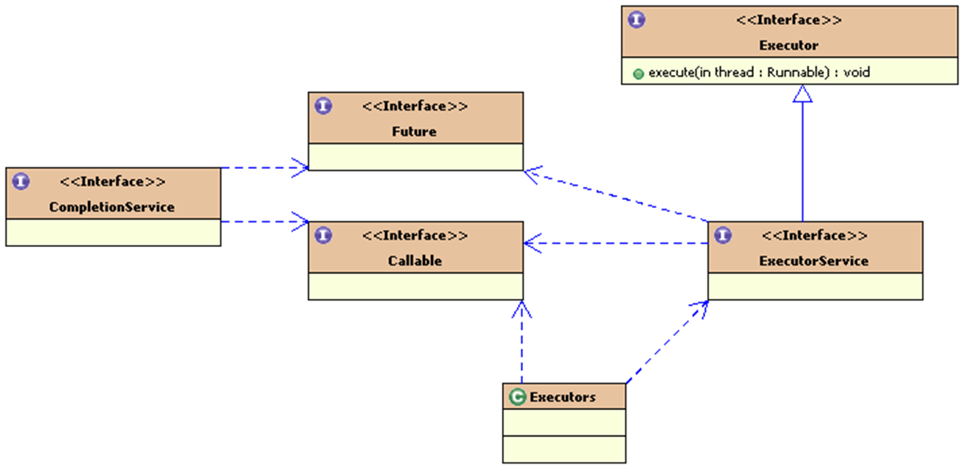

Slide 52
Executor Framework Components
The Executor framework consists of several key components:
1. Callable Interface: Similar to Runnable, Callable is designed for classes that can be executed by another thread. It provides a call() method, which has a return value and can throw exceptions. When a Callable object is submitted to a thread pool, a Future object is returned with the same generic type.
2. Future Interface: Used to cancel, check the status, and retrieve the result of a specific Runnable or Callable task. The get() method blocks until the task returns a result.
3. Executor Interface: Separates task submission from task execution and defines a method called execute() that receives a Runnable object.
4. ExecutorService Interface: A subclass of Executor, which defines methods for operating Executor, such as terminating tasks, submitting tasks, and tracking task return results.
5. Executors Class: Provides factory methods for creating thread pools, which implement the ExecutorService interface.
6. CompletionService: CompletionService is a variation of ExecutorService that maintains a BlockingQueue of Future objects. Tasks are added to the queue only when their status is completed, allowing for efficient retrieval of completed tasks.

Slide 53
Key Concepts
- Thread Pool: A group of threads that can be reused to execute multiple tasks, reducing the overhead of thread creation and termination.
- Task Submission: The process of submitting a task to a thread pool for execution.
- Task Execution: The process of executing a task by a thread in the thread pool.
- Future Object: A representation of a task's result, which can be used to retrieve the result or cancel the task.

Slide 54
Asynchronous Computing Program Structure Design Model
In multi-threaded programming, obtaining the results of asynchronous computing threads can be challenging. To address this issue, the Executor framework provides the Future interface, which allows for tracking the results of asynchronous computing. By using Future, a well-structured asynchronous computing program can be designed.
Based on Divide and Conquer Approach, The asynchronous computing threads can be divided into three categories based on their responsibilities:
1. Initiating Thread (Control Thread): Responsible for decomposing and initiating asynchronous computing tasks, assigning tasks to worker threads, and obtaining a collection of Futures to track the results of asynchronous computing.
2. Asynchronous Computing Work Thread: Responsible for executing specific computing tasks.
3. Asynchronous Calculation Result Collection Thread: Obtains the Future collection from the initiating thread, monitors the status of Futures, and processes the results of asynchronous calculation based on the status.

Slide 55
Benefits: This program structure design model provides several benefits:
- Simplified Asynchronous Computing: The use of Future and the division of responsibilities among threads simplify the process of asynchronous computing.
- Improved Error Handling: The separate thread for collecting results allows for better error handling and processing of asynchronous calculation results.
- Increased Scalability: The divide and conquer approach enables the program to scale more efficiently, as each thread can focus on its specific responsibility.
Best Practices: To implement this program structure design model effectively:
- Use Executor Framework: Leverage the Executor framework to manage threads and execute tasks asynchronously.
- Design Clear Thread Responsibilities: Ensure that each thread has a clear and specific responsibility to avoid confusion and errors.
- Monitor and Process Results: Implement a robust mechanism for monitoring and processing the results of asynchronous calculation to ensure accurate and timely results.

Slide 56
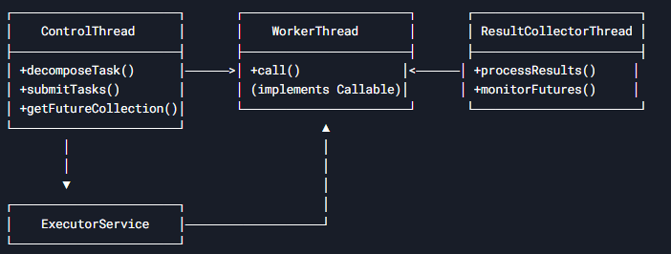
Here's a well-structured design pattern for asynchronous computing using Java's ExecutorService and Future framework, following the divide-and-conquer approach with three distinct thread responsibilities:
I. Class Diagram Overview

Slide 57
Implemenation : (1) Control Thread (Task Decomposition, Task submit, Get Future)
import java.util.*;
import java.util.concurrent.*;
public class ControlThread {
private final ExecutorService executor;
private List<Future<Result>> futures = new ArrayList<>();
public ControlThread(int threadPoolSize) {
this.executor = Executors.newFixedThreadPool(threadPoolSize);
}
// Decompose main task and submit subtasks
public void startProcessing(List<Task> subtasks) {
for (Task subtask : subtasks) {
Future<Result> future = executor.submit(new WorkerThread(subtask));
futures.add(future);
}
}
// Get Futures for monitoring
public List<Future<Result>> getFutureCollection() {
return Collections.unmodifiableList(futures);
}
public void shutdown() {
executor.shutdown();
}
}

Slide 58
(2) Worker Thread (Task Execution)
import java.util.concurrent.Callable;
public class WorkerThread implements Callable<Result> {
private final Task task;
public WorkerThread(Task task) {
this.task = task;
}
@Override
public Result call() throws Exception {
// Perform actual computation
return task.execute();
}
}

Slide 59
(3) Result Collector Thread (Monitoring & Processing)
import java.util.*;
import java.util.concurrent.*;
public class ResultCollectorThread implements Runnable {
private final List<Future<Result>> futures;
public ResultCollectorThread(List<Future<Result>> futures) {
this.futures = futures;
}
@Override
public void run() {
while (!allTasksCompleted()) {
try {
processCompletedTasks();
Thread.sleep(100); // Prevent busy waiting
} catch (InterruptedException e) {
Thread.currentThread().interrupt();
break;
}
}
processRemainingTasks();
}

Slide 60
private boolean allTasksCompleted() {
for (Future<Result> future : futures) {
if (!future.isDone()) return false;
}
return true;
}
private void processCompletedTasks() {
for (Future<Result> future : futures) {
if (future.isDone()) {
try {
Result result = future.get();
// Handle successful completion
System.out.println("Task completed: " + result);
} catch (InterruptedException e) {
Thread.currentThread().interrupt();
} catch (ExecutionException e) {
// Handle task failure
System.err.println("Task failed: " + e.getCause());
}
}
}
}
private void processRemainingTasks() {
// Process any remaining tasks after interruption
processCompletedTasks();
}
}

Slide 61
public class Main {
public static void main(String[] args) {
// 1. Prepare tasks
List<Task> tasks = prepareTasks();
// 2. Initialize control thread
ControlThread controller = new ControlThread(4);
// 3. Start processing
controller.startProcessing(tasks);
// 4. Start result collector
new Thread(new ResultCollectorThread(controller.getFutureCollection())).start();
// 5. Proper shutdown
Runtime.getRuntime().addShutdownHook(new Thread(() -> {
controller.shutdown();
}));
}
private static List<Task> prepareTasks() {
// Return list of tasks to execute
return Arrays.asList(
new Task("Task1"),
new Task("Task2"),
new Task("Task3")
);
}
}

Slide 62
IV. Key Design Features
Feature | Implementation
Separation of Concerns | Clear division between control, work, and collection
Non-blocking Monitoring | Result collector checks status without blocking main thread
Error Handling | Proper exception handling in result collector
Resource Management | ExecutorService lifecycle management
Thread Safety | Unmodifiable future collection for safe sharing

Slide 63
V. Performance Optimization Options
Callback Mechanism (Alternative to polling)回调机制，轮询的替代方案
future.thenAccept(result -> handleCompletion(result));
2. CompletionService (For result ordering):用于结果排序
CompletionService<Result> cs = new ExecutorCompletionService<>(executor);
Future<Result> future = cs.submit(new WorkerThread(task));
Result result = cs.take().get(); // Gets results in completion order
3. Timeout Handling:按顺序获取返回的结果
try {
Result result = future.get(1, TimeUnit.SECONDS);
} catch (TimeoutException e) {
future.cancel(true);
}

Slide 64
import java.util.concurrent.Callable;
import java.util.concurrent.ExecutionException;
import java.util.concurrent.ExecutorService;
import java.util.concurrent.Executors;
import java.util.concurrent.Future;
// Asynchronous computing work thread
class ComputingTask implements Callable<Integer> {
private int taskId;
public ComputingTask(int taskId) {
this.taskId = taskId;
}
@Override
public Integer call() {
// Simulate some computation
System.out.println("Computing task " + taskId);
try {
Thread.sleep(1000);
} catch (InterruptedException e) {
Thread.currentThread().interrupt();
}
return taskId * 10;
}
}
Result Collector Thread (Monitoring & Processing)
// Asynchronous calculation result collection thread
class ResultCollector {
public void collectResults(Future<Integer> future) {
try {
int result = future.get();
System.out.println("Result: " + result);
} catch (InterruptedException | ExecutionException e) {
Thread.currentThread().interrupt();
}
}
}
Worker Thread (Task Execution)

Slide 65
Control Thread (Task Decomposition, Task submit, Get Future)
public class AsynchronousComputingExample {
public static void main(String[] args) {
// Create an executor with a fixed thread pool size
ExecutorService executor = Executors.newFixedThreadPool(5);
// Initiating thread (control thread)
for (int i = 0; i < 10; i++) {
ComputingTask task = new ComputingTask(i);
Future<Integer> future = executor.submit(task);
// Asynchronous calculation result collection thread
ResultCollector collector = new ResultCollector();
collector.collectResults(future);
}
// Shut down the executor
executor.shutdown();
}
}

Slide 66
Explanation: This example demonstrates the use of the Executor framework to design a well-structured asynchronous computing program. The program consists of three categories of threads:
1. Initiating Thread (Control Thread): The main thread decomposes and initiates asynchronous computing tasks, assigns tasks to worker threads, and obtains a collection of Futures to track the results of asynchronous computing.
2. Asynchronous Computing Work Thread: The ComputingTask class implements the Callable interface and executes specific computing tasks.
3. Asynchronous Calculation Result Collection Thread: The ResultCollector class collects the results of asynchronous calculation based on the status of the Futures.
The program uses the Executor framework to manage threads and execute tasks asynchronously.
The ExecutorService interface is used to create an executor with a fixed thread pool size, and the submit() method is used to submit tasks to the executor.
The Future interface is used to track the results of asynchronous computing, and the get() method is used to retrieve the result of a task.

Slide 67
Asynchronous computing program structure example
Application Example: Use Executor framework multithreaded programming to find the maximum value in a large array of numbers.
Ch3.FindMaxInteger.FindMaxTask.java
Ch3.FindMaxInteger.MultithreadedMaxFinder.java
Ch3.FindMaxInteger.StartClass.java
Mainly use Future , Callable and Executor classes

Slide 68
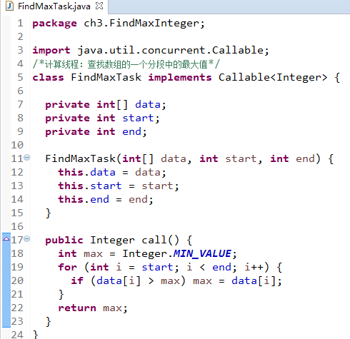
FindMaxTask.java: Asynchronous Computing Worker Thread

Slide 69
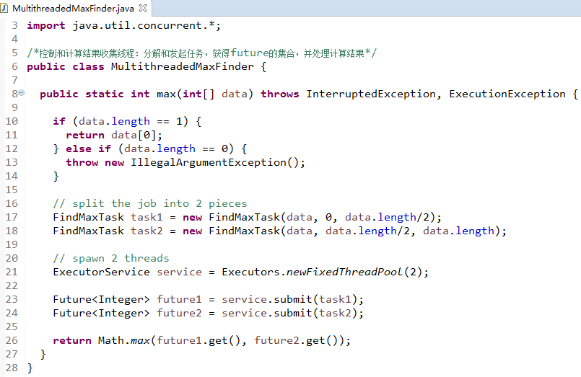
MultithreadedMaxFinder.java: Initiating Thread (Control Thread)
Task Decomposition, Task submit, Get Future

Slide 70
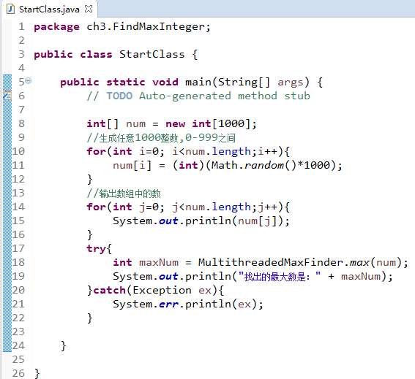
StartClass.java
Result Collector Thread (Monitoring & Processing)

Slide 71
Programming application problem scenario : compressed files
gzip compression
Application features: large number of I/O operations
Application characteristics: Data compression is high
Don't run too many threads at the same time
Programming with thread pools

Slide 72
Using thread pool to implement compressed file programming
Demonstration running sample code:
Ch3.threadPool.GZipAllFiles.java, GZipRunnable.java
Explain the program structure
Programming Ideas
Main program:
List the files in a directory and determine which file to compress
Fast execution speed
Compression Thread:
Compressed files
Slow execution speed
Limited number of thread
ExecutorServiece
Thread Pool
Run the main program in parallel with the compression thread
Run parameters:
C:\temp\ch3data\zip\File1
C:\temp\ch3data\zip\File2
C:\temp\ch3data\zip\ File3

Slide 73
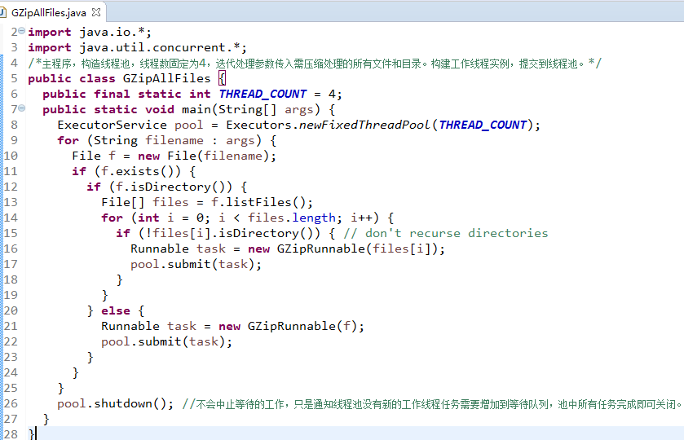
GZipAllFiles.java

Slide 74
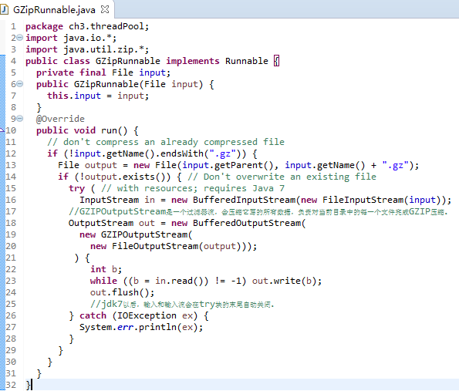
GZipRunnable.java

Slide 75
Using thread pool to implement compressed file programming
Program Structure
Runnable Interface
ExecutorService Interface
Executor Class
run( )
shutdown( )
submit( )
newFixedThreadPool()
Task:Runnable
pool: ExecutorService
GZipRunnable Class
input: File
run( )
GZipAllFiles Class
THREAD_COUNT=4
main( )

Slide 76
Thinking extension:
What classes are there to implement thread pools
Java implements thread pool using factory pattern. What is factory pattern?

Slide 77
Multiple threads accessing the same resource
Resources shared by multiple threads include memory, file handles, sockets , etc.
Multithreading shares resources. If the shared resources are not used at the same time, the program efficiency can be improved.
If shared resources are used simultaneously, they must be shared mutually exclusively. Only one thread is allowed to use them at a time, and the other threads have to wait. Otherwise, the resources will be destroyed and the program may be in chaos.
Shared resources
System.out
Thread 1
Thread 3
Thread 2
Thread 4
At a certain moment, thread 1 accesses, and threads 2 , 3 , and 4 wait.
When programming: You must be able to specify that a shared resource (several statements) can only be accessed exclusively by one thread.

Slide 78
Synchronous Block Programming Technology
Synchronous block programming technology refers to a programming approach where a block of code is executed synchronously i,e it is executed in a sequential and blocking manner.
In other words, when a synchronous block of code is executed, the program waits for the block to complete its execution before moving on to the next line of code.
This contrasts with asynchronous/non-blocking approaches.
Characteristics of Synchronous Block Programming
1. Blocking: Synchronous blocks of code are blocking, meaning that they prevent the program from executing other code until the block is complete.
2. Sequential Execution: Synchronous blocks of code are executed in a sequential manner, one line of code at a time.
3. No Concurrency: Synchronous blocks of code do not allow for concurrency, meaning that only one block of code can be executed at a time.
4. Thread Utilization: Threads wait idle during I/O operations

Slide 79
Advantages of Synchronous Block Programming
1. Easier to Understand and Debug: Synchronous blocks of code are often easier to understand and debug because they are executed in a sequential and predictable manner.
2. Less Complexity: Synchronous blocks of code typically have less complexity than asynchronous code, which can make them easier to maintain and modify.
Disadvantages of Synchronous Block Programming
1. Performance Limitations: Synchronous blocks of code can limit the performance of a program because they can block other code from executing.
2. Limited Scalability: Synchronous blocks of code can limit the scalability of a program because they can become a bottleneck as the program grows.
Use Cases for Synchronous Block Programming
1. Synchronous blocks of code are often used in simple programs where concurrency is not a concern.
2. Synchronous blocks of code are often used in critical sections of code where data integrity is crucial

Slide 80
Imagine you have a bank account and you want to withdraw money from it. In a synchronous block programming approach, the steps would be:
1. Check if you have enough money in your account.
2. If you do, subtract the amount you want to withdraw from your account.
3. Update your account balance. , Here's some simple Java code to illustrate this:
In this example, the withdraw method is a synchronous block of code. When you call account.withdraw(50), the program will:
1. Check if you have enough money in your account (i.e., balance >= amount).
2. If you do, subtract the amount from your account (i.e., balance -= amount).
3. Update your account balance (i.e., print the new balance).
The synchronized keyword ensures that only one thread can execute the withdraw method at a time, making it a synchronous block of code.
public class BankAccount {
private int balance = 100;
public synchronized void withdraw(int amount) {
if (balance >= amount) {
balance -= amount;
System.out.println("Withdrew " + amount + ". New balance: " + balance);
} else {
System.out.println("Insufficient funds");
}
}
public static void main(String[] args) {
BankAccount account = new BankAccount();
account.withdraw(50);
}
}

Slide 81
Synchronous block programming technology
Statements that require exclusive access:
System.out.print( input + “:” );
System.out.print(DatatypeConverter.printHexBinary(digest));
System.out.println() ;
Add a synchronized block:
Synchronized ( System.out ) {
System.out.print( input + “:” );
System.out.print(DatatypeConverter.printHexBinary(digest));
System.out.println() ;
}
The synchronized keyword ensures that only one thread can execute the System.out {} block at a time, making it a synchronous block of code.

Slide 82
Synchronous block programming technology application example
Multithreaded access to log files on
Multiple threads will obtain the LogFile object to write current date and time into the log file.
How can I programmatically handle this to avoid confusion?
Connection thread 3 : handles inbound connections
Connection thread 1 : handles inbound connections
Log files
LogFile
Connection thread 4 : handles inbound connections
Connection thread 2 : handles inbound connections

Slide 83
Benefits of Synchronous Block for Logging
Using a synchronous block for logging provides several benefits:
1. Thread Safety: The synchronous block ensures that multiple threads cannot write to the log file simultaneously, which could cause data corruption or other issues.
2. Consistency: The synchronous block ensures that the log file is updated consistently, even in the presence of multiple threads.
3. Atomicity: The synchronous block ensures that each log message is written to the file atomically, meaning that either the entire message is written or none of it is.

Slide 84
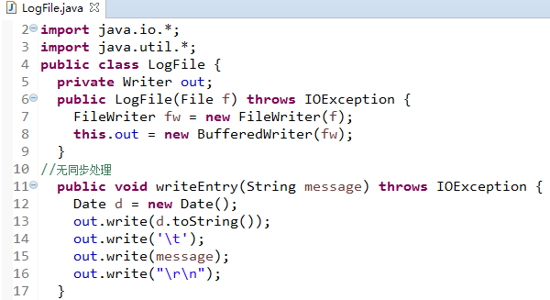
LogFile.java 无线程安全
No synchronous processing

Slide 85
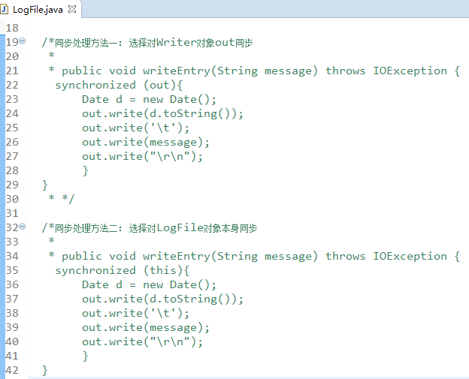
LogFile.java
Synchronization method 1:Choose to synchronize the Writer object out
Synchronization method 2: Choose to synchronize the LogFile object itself

Slide 86
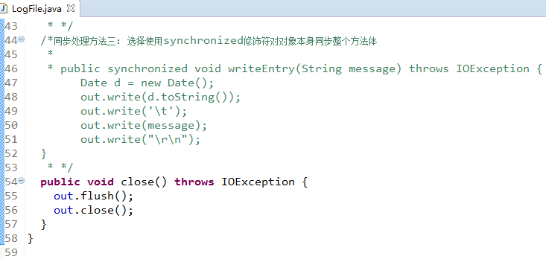
LogFile.java
Synchronization method 3: Choose to synchronize the whole method body with the synchronized modifier on the object itself

Slide 87
Programming thinking problem
Improve the file security algorithm summary saving program completed in the last programming thinking problem, and give a file security algorithm summary log generation program.
Requirement: Use multi-threaded synchronous programming technology to save the file security algorithm summary calculated by the file security algorithm summary calculation program (using multi-threaded calculation) into a log file.
For example, the security algorithm summary calculated for the 1.txt file is stored in a log file named SafeLogFile.txt , and the security algorithm summary calculated for the 2.xml file is also stored in a file named SafeLogFile.txt .
And when storing the security algorithm summary of a file in the SafeLogFile.txt log file, the generation time of the security algorithm summary of the file must also be stored.

Slide 88
Problems that may arise from synchronous block programming techniques
1. It may seriously degrade the performance of the VM , reducing the code execution speed by one third or more
2. Greatly increases the possibility of deadlock
3. It is not the object itself that needs to be protected from simultaneous modification or access . If only the instance of the class to which the method belongs is synchronized , it may not protect the object that really needs to be protected .
Connection thread 3 : handles inbound connections
Log files
LogFile
Out object: Writer
Connection thread 1 : handles inbound connections
Connection thread 2 : handles inbound connections
Connection thread 4 : handles inbound connections
Problems caused: The goal is to avoid 4 threads writing to the log file using the out object at the same time, but if other classes have references to out that are completely unrelated to LogFile , these writes will fail.

Slide 89
Replacement technology for synchronous programming technology
Using synchronous programming techniques to solve inconsistency problems that may be caused by thread scheduling will introduce new problems, called synchronization problems.
Think about it: What are some alternative programming techniques that can solve the inconsistency problems that may be caused by multi-threaded resource sharing, and avoid synchronization problems caused by the use of synchronization?
Method 1 : Try to use local variables instead of fields
Method 2 : Basic type method parameters, constructors are usually thread-safe
Method 3 : Use a non-thread-safe class as a private field of a thread-safe class.

Slide 90
Thread Scheduling
Multithreaded programs need to consider thread scheduling issues
Important threads get CPU time to run, more important threads get more time , and can now execute in a reasonable order
Priority : In Java , each thread has a priority, specified as an integer from 0 to 10. The virtual machine schedules the execution of threads with higher priority first . 10 is the highest priority, 0 is the lowest, and the default priority is 5. Usually, the threads in our program are all at the default priority .
Thread.MIN_PRIORITY = 1 , Thread.NORM_PRIORITY = 5, Thread.MAX_PRIORITY = 10

Slide 91
Thread Scheduling
Thread Scheduler : Each virtual machine has a thread scheduler that determines which thread is running at a given time.
Thread scheduling methods : preemptive and cooperative
The preemptive thread scheduler periodically interrupts the currently executing thread and transfers CPU control to another thread.
A cooperative thread scheduler waits for the currently running thread to pause itself before handing control of the CPU to another
When writing a Java thread program to implement the run () method, make sure that the thread has conditions that allow it to be suspended so that other threads have a chance to run.
There are several ways to pause a thread :
on I/O , block on synchronization object, give up, sleep, connect to another thread, wait for an object, end, can be preempted by a higher priority thread, etc.

Slide 92
Questions to think about
1. What is thread deadlock problem
2. What is thread starvation problem
Thread deadlock: Deadlock occurs when two threads need exclusive access to the same set of resources, but each thread has locks on a different subset of these resources.
Thread starvation: When thread scheduling is running, some threads cannot get CPU time slices and are always in a waiting state, unable to run tasks.

Slide 93
Programming problem scenario: Calculate and display the summary of multiple file security algorithms
Thread 1 : File security algorithm summary generation thread
ReturnDigest
getDigest()
Main thread: File security algorithm summary display
getDigest()
Thread 2 : File security algorithm summary generation thread
ReturnDigest
… …
Thread n : File security algorithm digest generation thread
ReturnDigest
getDigest()

Slide 94
Problem continued: Multithreaded programming using accessor methods
Thread Class
ReturnDigestUserInterface Class
run ()
start( )
main( )
dr : ReturnDigest
dr
ReturnDigest Class
filename
digest
There is a problem with using access methods to obtain the output of the calculation thread. The speed of the main() method will exceed the thread that generates the result, and a null pointer exception will occur.
filename: String
digest: byte[]
run( )
getDigest()
start( )
getDigest ()

Slide 95
Problem Solving: Using Connection Threads
Thread 1 : File security algorithm summary generation thread
ReturnDigest
join
Main thread: File security algorithm summary display
join
Thread 2 : File security algorithm summary generation thread
ReturnDigest
join
… …
Thread n : File security algorithm digest generation thread
ReturnDigest

Slide 96
Multithreaded programming using the join thread method
Thread Class
run ()
start( )
join( )
JoinDigestUserInterface Class
main( )
digestThreads
ReturnDigest Class
digestThreads : ReturnDigest [ ]
filename: String
digest: byte[]
start( )
join( )
getDigest ()
run( )
getDigest()
Code example demonstration and operation: ch3.JoinDigestUserInterface.java, ex3-12
Compare and run ch3.returnInfo.ReturnDigestUserInterface.java

Slide 97
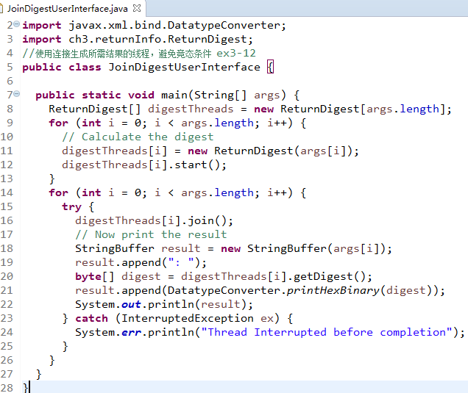
JoinDigestUserInterface.java

Slide 98
Connecting thread programming techniques
Allows a thread to wait for another thread to complete before continuing execution
calls the join() method the joining thread ( join thread) , waiting for the thread to be connected (joined thread) ( the join method belongs to the connected thread).
Question: In the above ex3-12 program design, which one is the connecting thread? Which one is the connected thread?

Slide 99
Connecting thread programming techniques
By calling the join() method, a thread is allowed to wait for another thread to finish before continuing . How long should the joining thread wait?
Depends on the join() parameter:
join() ---- infinitely wait for the connected thread to end
join( long milliseconds )---- Wait for milliseconds microseconds and then continue execution.
join ( long milliseconds, int nanoseconds ) --- Wait for nanoseconds milliseconds or milliseconds microseconds before continuing

Slide 100
Thanks

Slide 101
Multi-threaded File Compression Program with Future Tracking
Click the link below to view the complete Java implementation that compresses multiple files asynchronously using the Executor framework with all the following features:
AsyncFileCompressor.java
Three-Tier Architecture
CompressionController: Decomposes and initiates tasks
CompressionWorker: Performs actual file compression (implements Callable)
ResultCollector: Monitors and processes results
Future-Based Tracking
Controller maintains List<Future<CompressionResult>>
Result collector monitors completion status
Comprehensive Result Handling
Tracks original/compressed sizes
Measures processing time
Captures success/failure status
Proper Resource Management
Uses try-with-resources for file streams
Clean executor shutdown
CountDownLatch for completion tracking
Error Resilience
Individual task failures don't stop overall processing
Detailed error reporting

Slide 102
Thanks

